Slide 1

FITMOD
Your Healthcare Companion…

Slide 2
CONTENT
01
PROBLEM STATEMENT
02
OBJECTIVE
03
FEATURES
04
MODULES USED
05
CODE SNIPPETS & OUTPUT

Slide 3
01
PROBLEM STATEMENT
01
To create an application that helps users to track their health with ease
Notes:
When we first started to brainstorm for this project, we wanted to create a prototype of an application that will allow users to understand their detailed and scientific health reports easily, in layman terms.

Slide 4
02
OBJECTIVE
02
To create an application that assists users to digitalize their health reports, track their health history, and avail doctors with ease

Slide 5
03
FEATURES
03
Upload and save user’s health report
View variation in health parameters
Display health history of user over a period of time for each individual health parameter
Obtain information regarding health specialists based on abnormal parameters

Slide 6
04
MODULES USED
04
tkinter
mysql connector
matlpotlib

Slide 7
05
CODE SNIPPETS AND OUTPUT
05
Program
SQL Database
Application

Slide 8
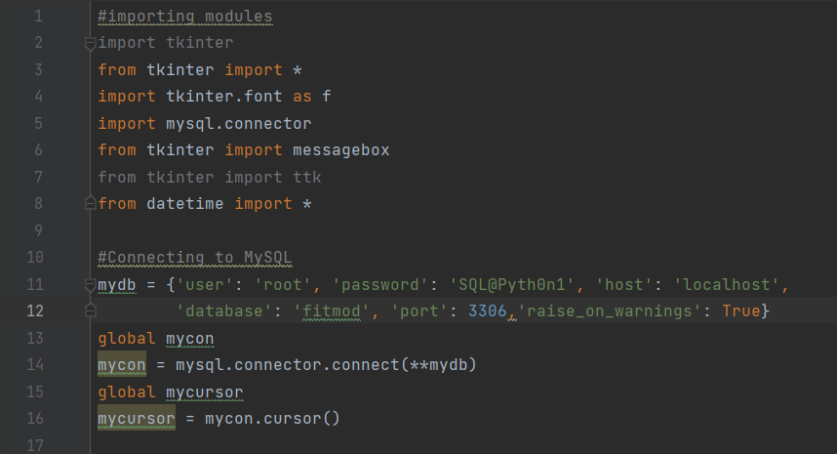
CODE SNIPPETS
Importing modules

Slide 9
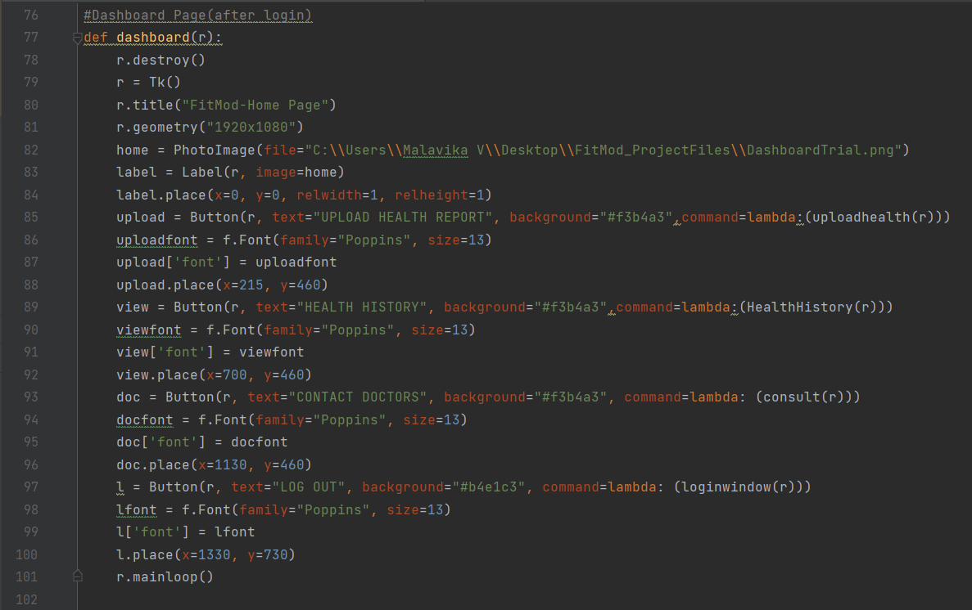
CODE SNIPPETS
Dashboard Page

Slide 10
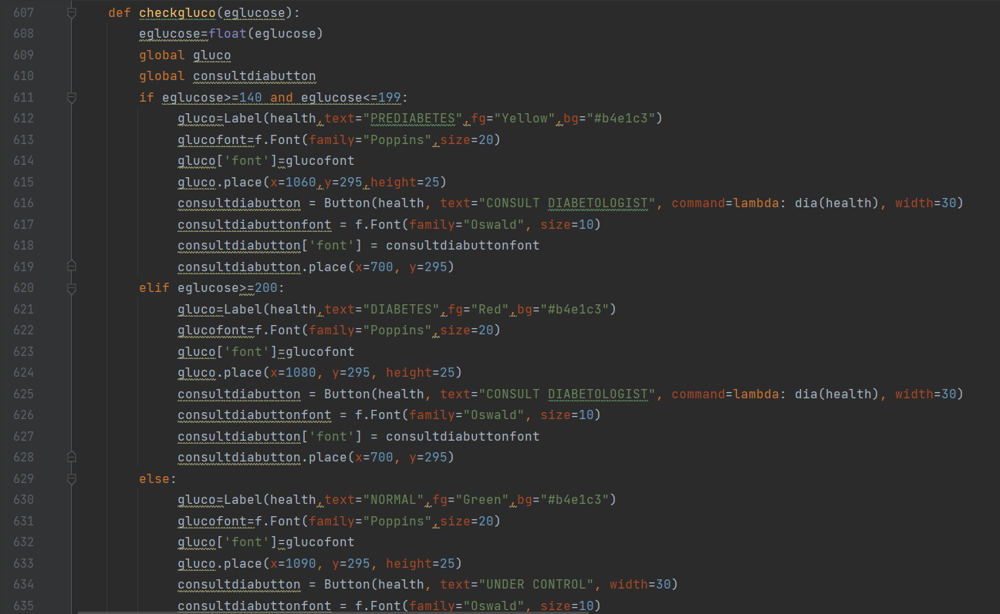
CODE SNIPPETS
Checking Glucose Levels

Slide 11
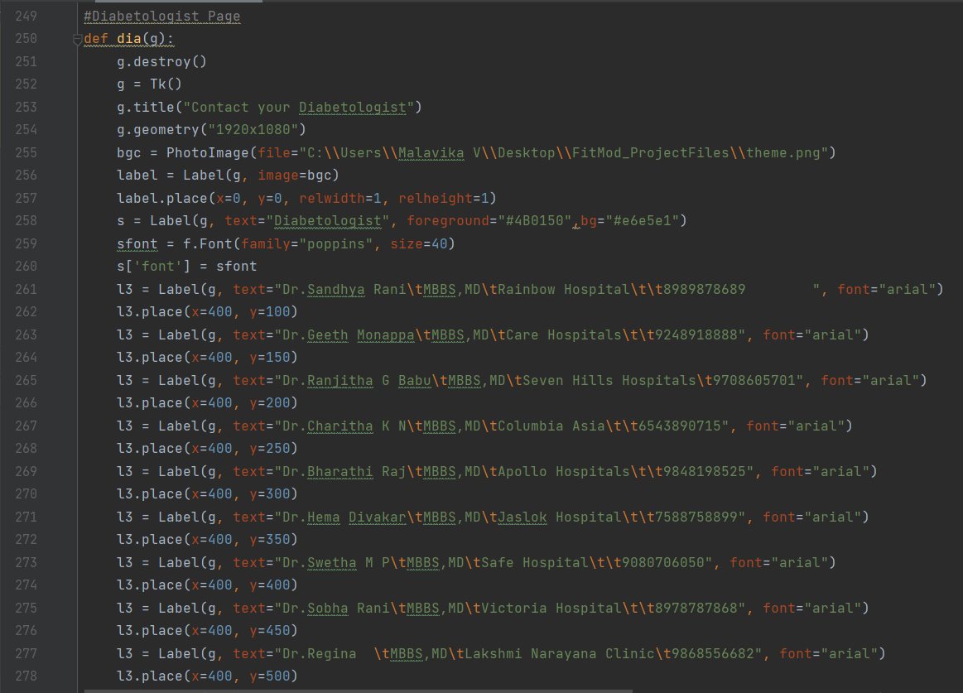
CODE SNIPPETS
Diabetologists Information

Slide 12
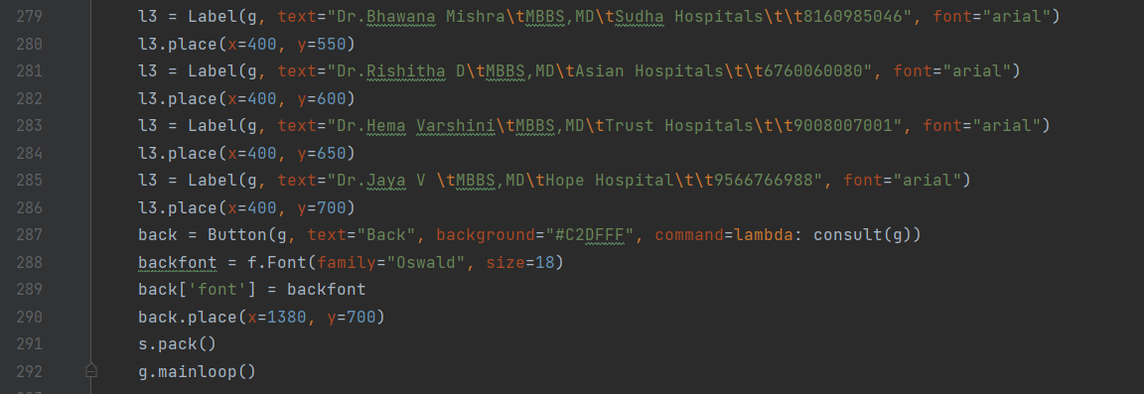
CODE SNIPPETS
Diabetologists Information

Slide 13
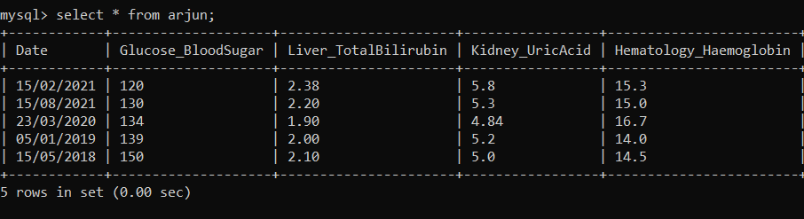
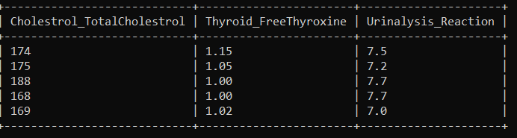
SQL DATABASE
Data of User

Slide 14
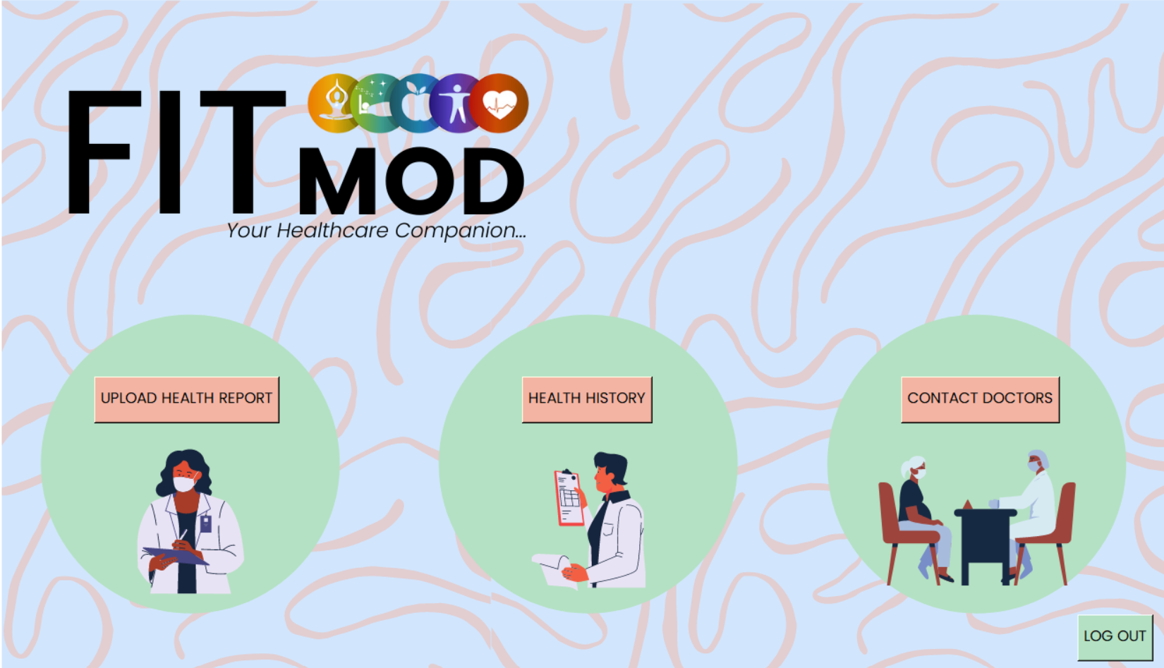
OUTPUT
Dashboard Page

Slide 15
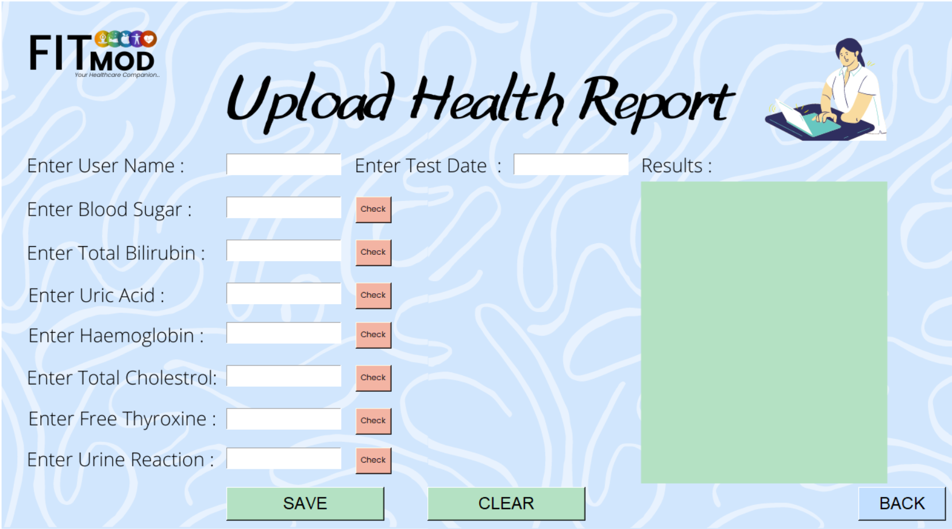
OUTPUT
Upload Health Report Page

Slide 16
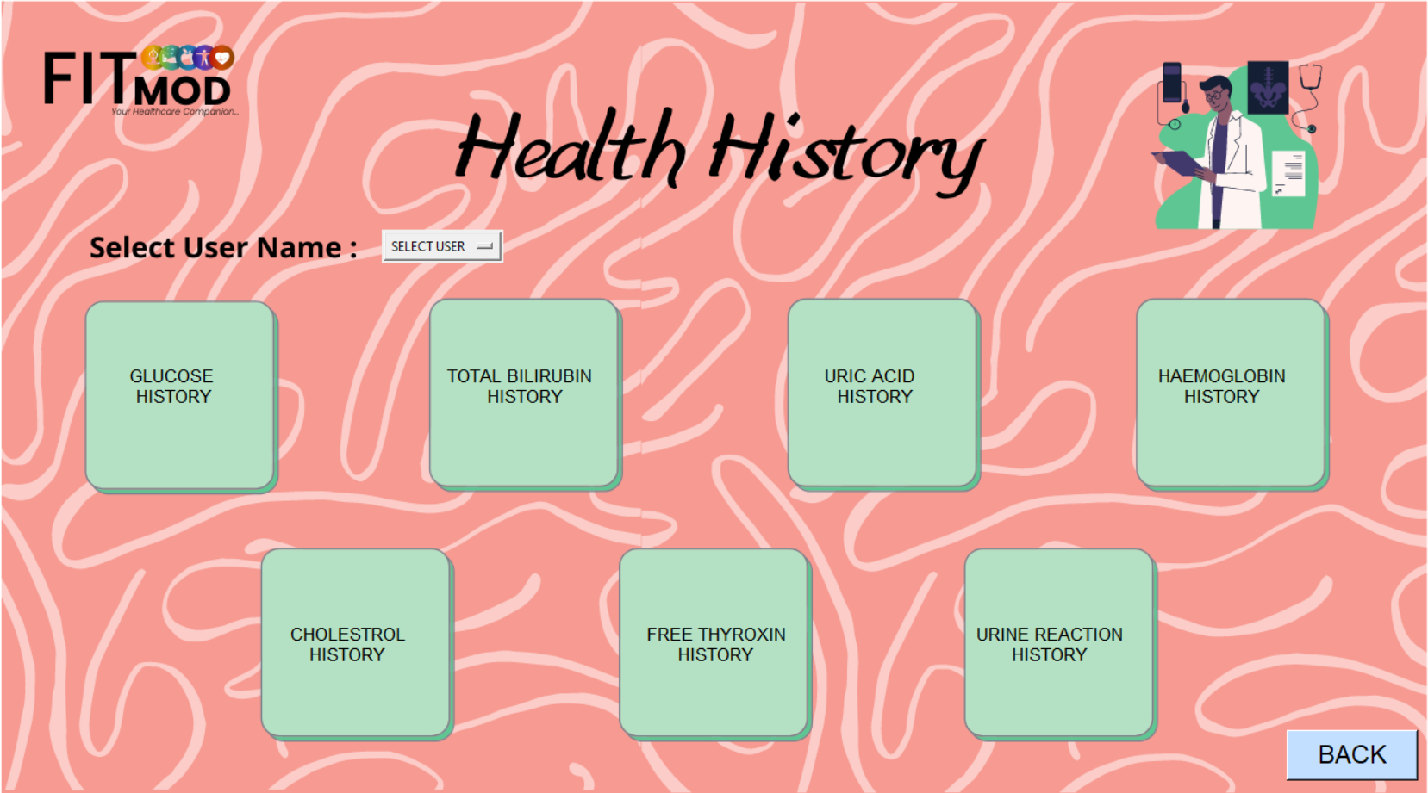
OUTPUT
Health History Page

Slide 17

OUTPUT
Contact Doctor Page

Slide 18
DEMO

Slide 19
TEAM
M NIKITA MABEL
SREE HEMA HASMITA
MALAVIKA V

Slide 20
THANK YOU !

